Slide 1
Project 1: Integration of Merge Sort & Insertion Sort
Ng Zheng Ning
Nguyen Xuan Hoang
Ng Yee Teck

Slide 2
Overview
Prelude
Part (a)
Part (b)
Part (c)
Part (d)
Codebase

Slide 3

Prelude: Merge Sort
Divide the array until the subarrays are size $1$, then merge the sub arrays back while sorting them.
Time complexity: $O(n\log\left(n\right))$ for all cases ($n$ symbols the array size)
Image below: Merge Sort Implementation

Slide 4
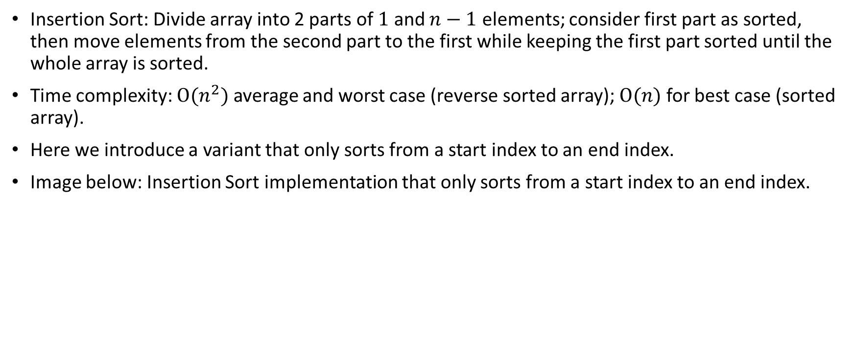
Prelude: Insertion Sort
Insertion Sort: Divide array into 2 parts of $1$ and $n−1$ elements; consider first part as sorted, then move elements from the second part to the first while keeping the first part sorted until the whole array is sorted.
Time complexity: $O(n^{2})$ average and worst case (reverse sorted array); $O(n)$ for best case (sorted array).
Here we introduce a variant that only sorts from a start index to an end index.
Image below: Insertion Sort implementation that only sorts from a start index to an end index.

Slide 5
Prelude: Key Comparison
Define what a “Key Comparison” is in this slide and how to measure in Insertion/Merge Sort.

Slide 6

Part (a) - Algorithm implementation
The algorithm requires to combine Merge Sort and Insertion Sort in a way such that the subarrays divided by Merge Sort can only have a minimum size of $S$. If the subarray’s size is smaller than $S$, Insertion Sort will be used.
The way to do is to bake the Insertion Sort into the base case of the division/recursion function of Merge Sort.
Images below: Comparison of the normal and modified divide function in Merge Sort.

Slide 7
Part (a) - Algorithm implementation
Full Image of the Algorithm here

Slide 8

Part (b) - Generate input data
We generated arrays with sizes from ${10}^{3}$ to ${10}^{8}$ with the script below.
We set the maximum allowed value for our datasets to be ${10}^{8}+5$.
Image of script below

Slide 9

Part (c) - Analyze time complexity
Part (c) i.: Fixed $S$, measure number of key comparisons over $n$.
Write something here and add some plots/figs/scripts.

Slide 10
Part (c) - Analyze time complexity
Part (c) ii.: Fixed n, measure number of key comparisons over S.
Write something here and add some plots/figs/scripts.

Slide 11

Part (c) - Analyze time complexity
Part (c) iii.: Varied $n$, find optimal $S$.
Write something here and add some plots/figs/scripts.
Thus, the optimal value of $S$ is …

Slide 12

Part (d) - Compare with original Merge Sort
We have the plots showing the time and key comparisons of Merge Sort against the hybrid sorting algorithm in (a) ($S= <Optimal S in last slide>$) for $n={10}^{8}$.
Some analysis…
Give image of script here

Slide 13
Part (d) - Compare with original Merge Sort
Give image of script here

Slide 14
Codebase
Codebase: <Add GitHub/Google Drive/OneDrive link here>

